Slide 1
AWS databases
Beograd, 25.10.2022.

Slide 2
Agenda
01
RDS
02
RDS Custom
03
Amazon Aurora
04
Amazon ElastiCache
05
DynamoDB basics
06
DynamoDB in details
07​
DynamoDB hans on

Slide 3
Amazon RDS Overview
RDS stands for Relational Database Service
It’s a managed DB service for DB use SQL as a query language.
It allows you to create databases in the cloud, managed by AWS
Databases:
Postgres
MySQL
MariaDB
Oracle
Microsoft SQL Server
Aurora (AWS Proprietary database)

Slide 4
RDS versus deploying DB on EC2
RDS is a managed service:
Automated provisioning, OS patching
Continuous backups and restore to specific timestamp (Point in Time Restore)!
Monitoring dashboards
Read replicas for improved read performance
Multi AZ setup for DR (Disaster Recovery)
Maintenance windows for upgrades
Scaling capability (vertical and horizontal)
Storage backed by EBS (gp2 or io1)
BUT you can’t SSH into your instances

Slide 5
RDS – Storage Auto Scaling
Helps you increase storage on your RDS DB instance dynamically
You have to set Maximum Storage Threshold (maximum limit for DB storage)
Automatically modify storage if:
Free storage is less than 10% of allocated storage
Low-storage lasts at least 5 minutes
6 hours have passed since last modification
Useful for applications with unpredictable workloads
Supports all RDS database engines (MariaDB, MySQL, PostgreSQL, SQL Server, Oracle)

Slide 6
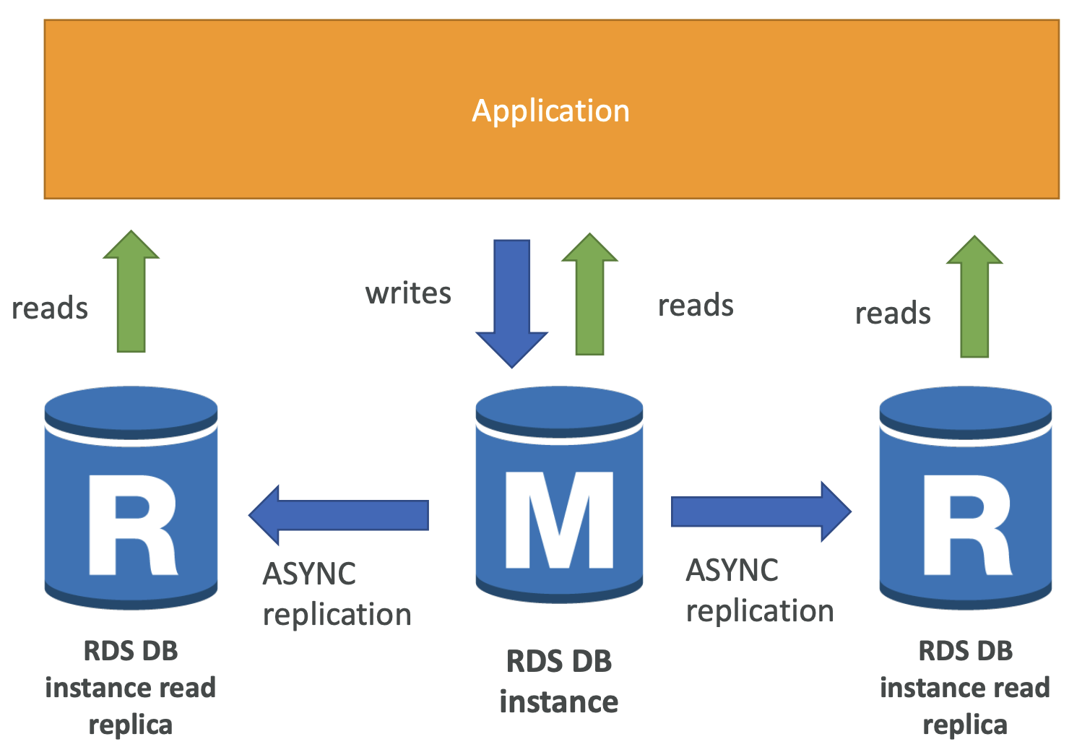
RDS Read Replicas for read scalability
Up to 5 Read Replicas within AZ, cross AZ or cross Region
Replication is ASYNC, so reads are eventually consistent
Replicas can be promoted to their own DB
Applications must update the connection string to leverage read replicas

Slide 7
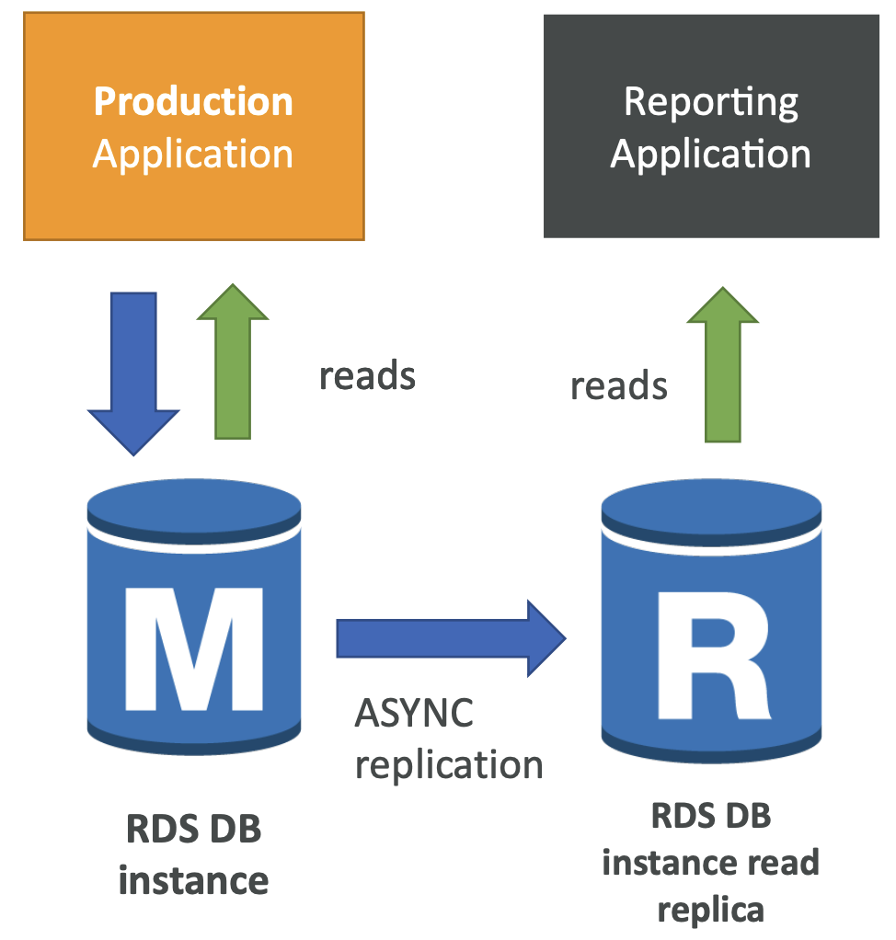
RDS Read Replicas – Use Cases
You have a production database that is taking on normal load
You want to run a reporting application to run some analytics
You create a Read Replica to run the new workload there
Read replicas are used for SELECT

Slide 8
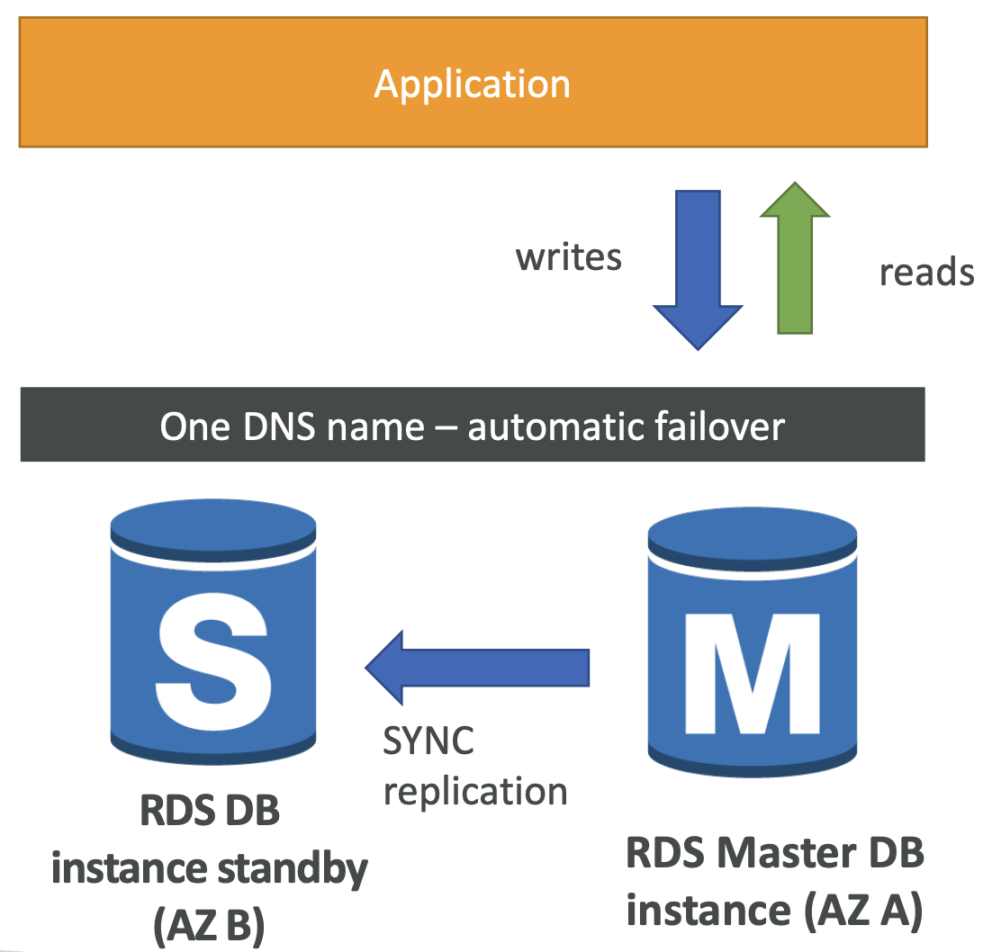
RDS Multi AZ (Disaster Recovery)
SYNC replication
One DNS name – automatic app failover to standby
Failover in case of loss of AZ, loss of network, instance or storage failure
No manual intervention in apps

Slide 9
RDS Custom
Managed Oracle and Microsoft SQL Server Database with OS and database customization
RDS: Automates setup, operation, and scaling of database in AWS
Custom: access to the underlying database and OS so you can:
Configure settings
Install patches
Enable native features
Access the underlying EC2 Instance using SSH or SSM Session Manager
RDS vs. RDS Custom
RDS: entire database and the OS to be managed by AWS
RDS Custom: full admin access to the underlying OS and the database

Slide 10

Amazon Aurora
Aurora is a proprietary technology from AWS (not open sourced)
Postgres and MySQL are both supported as Aurora DB (that means your drivers will work as if Aurora was a Postgres or MySQL database)
Aurora is “AWS cloud optimized” and claims 5x performance improvement over MySQL on RDS, over 3x the performance of Postgres on RDS
Aurora can have 15 replicas while MySQL has 5, and the replication process is faster (sub 10ms replica lag)
Aurora costs more than RDS (20% more) – but is more efficient

Slide 11
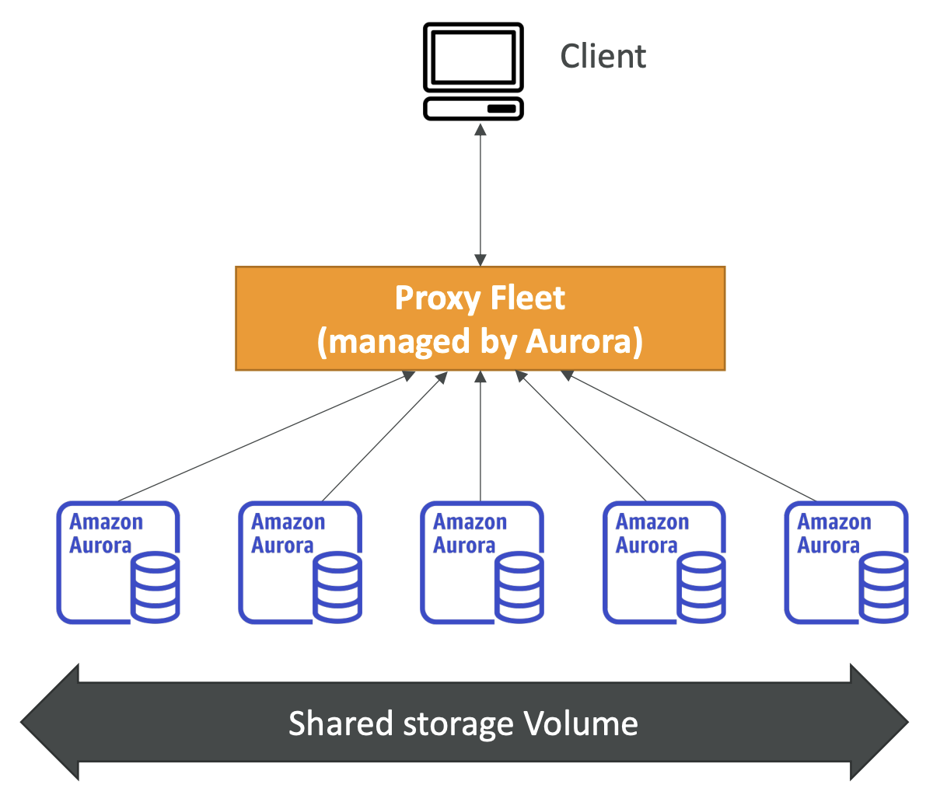
Aurora Serverless
Automated database instantiation and auto - scaling based on actual usage
Good for infrequent, intermittent or unpredictable workloads
No capacity planning needed
Pay per second, can be more cost -effective

Slide 12

Amazon ElastiCache
The same way RDS is to get managed Relational Databases, ElastiCache is to get managed Redis or Memcached
Caches are in-memory databases with really high performance, low latency
Helps reduce load of databases for read intensive workloads
AWS takes care of OS maintenance / patching, optimizations, setup, configuration, monitoring, failure recovery and backups
Cache must have an invalidation strategy to make sure only the most current data is used in there

Slide 13
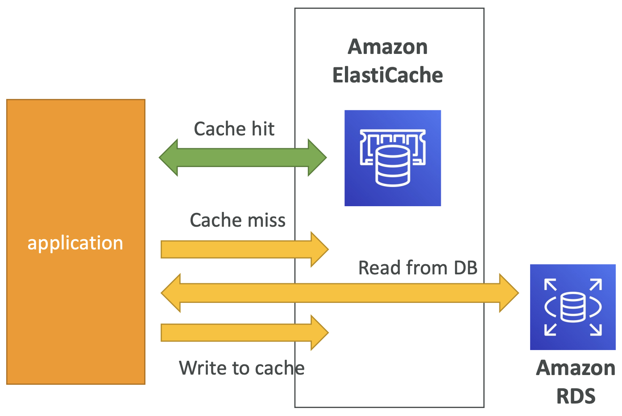
Patterns for ElastiCache

Slide 14
Cache invalidation
There are only two hard things in Computer Science:
cache invalidation and naming things. :)
What should be cached (good candidates)?
long-running queries on databases,
high-latency network requests (for external APIs),
computation-intensive processing
Cache invalidation strategies
Expiration time (TTL) – Mondo example
Write Through: Adds or update data in the cache when written to a DB

Slide 15
No sql databases
NoSQL databases are non-relational, distributed databases
NoSQL databases don't support query joins (or just limited support)
All the data that is needed for a query is present in one row
NoSQL databases don't perform aggregations such as SUM, AVG...
NoSQL databases scale horizontally
Examples:
DynamoDB
DocumentDB

Slide 16
DynamoDB overview
DynamoDB is made of tables
Each table has a primary key (must be decided at creation time)
Each table can have infinite number of items (rows)
Each item has attributes (can be added over time, can be null)
Maximum size of an item is 400KB
DynamoDB replicates table data in 3 availability zones within a single region
Supported data types are:
Scalar types – String, Number, Binary, Boolean, Null
Document types – List, Map
Set types – String Set, Number Set, Binary Set

Slide 17
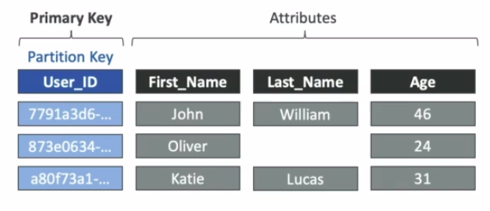
DYNAMODB – primary keys
Option 1: Partition key
Must be unique for each item
Must be "diverse" so that the data is distributed
Example: "USER_ID" for a users table

Slide 18
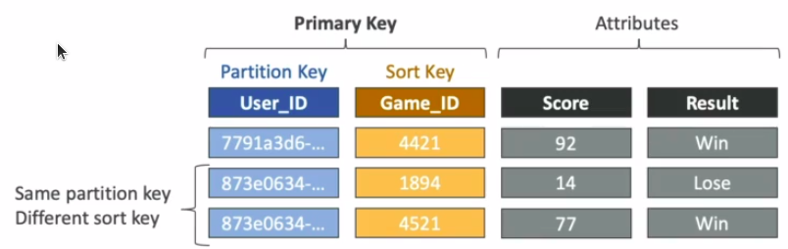
Dynamodb – primary keys
Option 2: Partition key + Sort key
The combination must be unique for each item
Data is grouped by partition key
Example: users-games table, "USER_ID" for Partition key, "GAME_ID" for Sort key

Slide 19
DYNAMODB – r/w capacity modes
Control how you manage table's capacity
Provisioned mode (default)
You specify the number of reads/writes per second
You need to plan capacity beforehand
Pay for provisioned read & write capacity units
On-demand mode
Read/writes automatically scale up/down with your workloads
No capacity planning needed
Pay for what you use, more expensive

Slide 20
Dynamodb – provisioned mode
Table must have provisioned read and write capacity units
Write capacity units (WCU) - throughput for writes
One Write capacity unit (WCU) represents one write per second for an item up to 1KB in size
If the items are larger than 1KB, more WCUs are consumed
Read capacity units (RCU) - throughput for reads
There are two types of reads:
Eventually consistent read
Strongly consistent read
One RCU represents one strongly consistent read per second or two eventually consistent reads per second, for an item up to 4KB in size

Slide 21
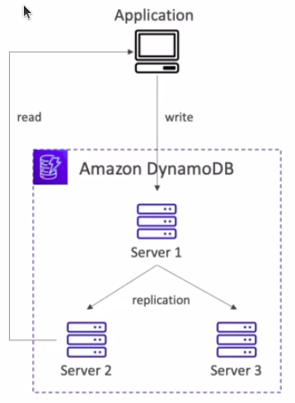
Dynamodb – read
Eventually consistent read
If we read just after a write, it is possible we'll get some stale data because of the replication
Strongly consistent read
If we read just after a write, we will get the correct data
Set "Consistent read" parameter to TRUE
Consumes twice the RCU

Slide 22
Dynamodb – rcu/wcu
Example 1: We write 6 items per second, with item size 4.5KB. How many WCUs do we need?
6 * (5KB/1KB) = 30 WCUs
Example 2: We have 16 Eventually consistent reads per second, with item size 12KB. How many RCUs do we need?
(16/2) * (12KB/4KB) = 24 RCUs
Example 3: We have 10 Strongly consistent reads per second, with item size 6KB. How many RCUs do we need?

Slide 23
Dynamo db – rcu/wcu
10 * (8KB/4KB) = 20RCUs

Slide 24
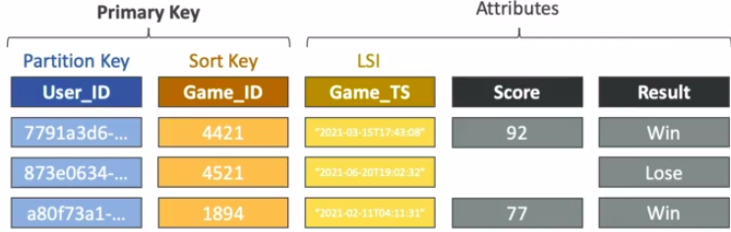
Dynamodb – indexes
Two types of indexes: Local secondary index (LSI) & Global secondary index (GSI)
Local secondary index (LSI) represents the alternative sort key for your table (same partition key)
You can add up to 5 LSIs to table
Must be defined at table creation time
Attribute projections – can contain some or all the attributes

Slide 25
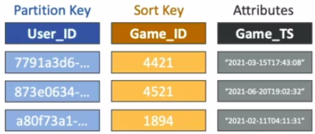
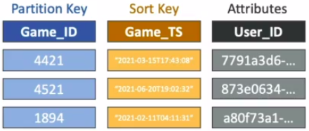
Dynamodb – indexes
Global secondary index (GSI) represents an alternative primary key to speed up queries on non-key attributes
Attribute projections – can contain some or all the attributes
Must provision RCUs & WCUs for the index
Can be added/modified after table creation

Slide 26
Dynamodb – streams
Streams are an ordered list of item-level modifications such as CREATE, UPDATE, DELETE
The data retention is up to 24 hours
Use cases:
React to changes in real-time (welcome email to new users)
Analytics
Insert into ElasticSearch
Implement cross-region replication

Slide 27
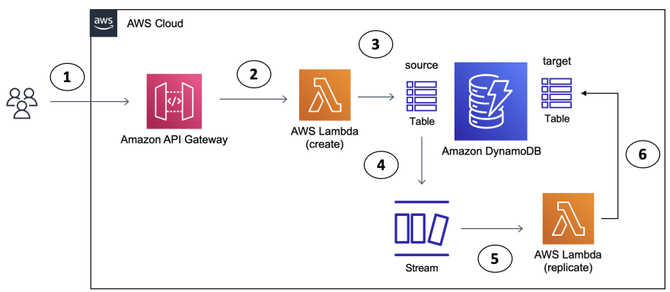
Dynamodb – streams example

Slide 28
Dynamodb – streams
In the stream we have the ability to choose the information that will be written into stream:
KEYS_ONLY – only the key attributes of the modified item
NEW_IMAGE – the entire item, after modification
OLD_IMAGE – the entire item, before modification
NEW_AND_OLD_IMAGES – both the new and the old images of the item

Slide 29
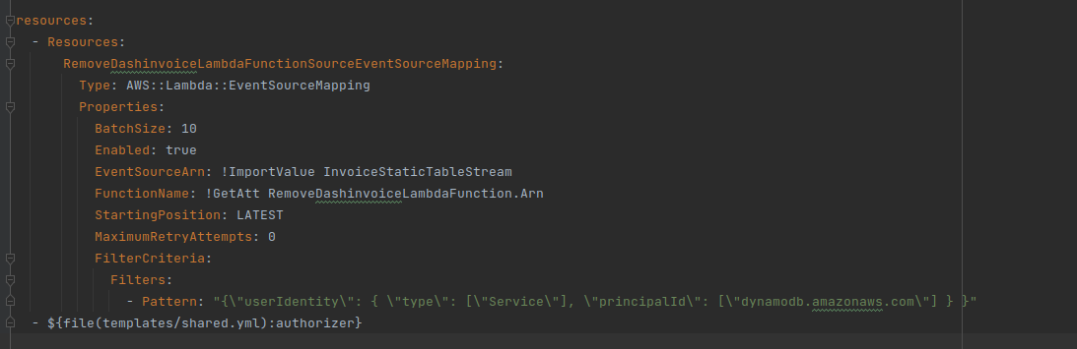
Dynamodb – example of Event source mapping for streams

Slide 30
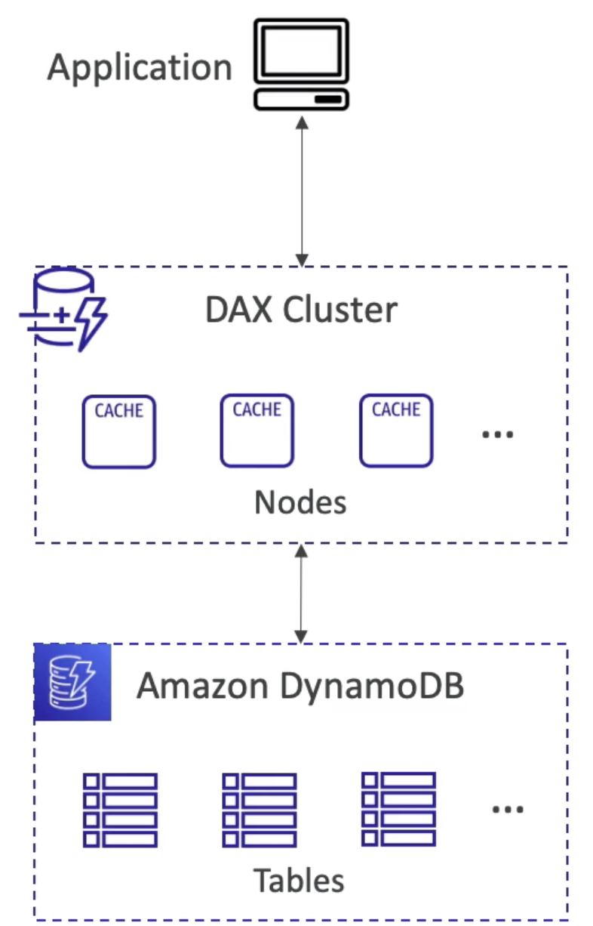
Dynamodb Accelerator– DAX
Fully managed, highly available cache for DynamoDB
Caching most popular data, you get microseconds latency for cached reads and queries
Solves Hot Key problem – too many reads of the same item
When to use:
For caching queries, scans and individual object

Slide 31
Dynamodb – EXAMPLE
git clone https://github.com/hasanovicmina/matflevi9-dynamodb-example.git
cd matflevi9-dynamodb-example
npm i
For deploying: sls deploy

Slide 32
Useful links
Serverless framework commands
Serverless AWS credentials

Slide 33
Any questions
m.hasanovic@levi9.com
m.rajevic@levi9.com
a.krizan@levi9.com
33

